Slide 1
Implementation of Login using php and MySQL
CT4009
Week 7 – Lab Worksheet

Slide 2
Purpose of this lab…
Implementation of “Flogger Sell Item” page so that item images can be uploaded to a server folder and keep a record in the database of the files that were saved so the images can be referenced when needed.

Slide 3
Set up your Folders…
Create the following three folders
include – copy the database configuration file (config.php) from previous week implementation
SellItem – create and save the following three files in this folder as shown in the next slides
SellItem.html
SellItem.js
SellItemDAO.php
ItemImages – to save the uploaded images

Slide 4
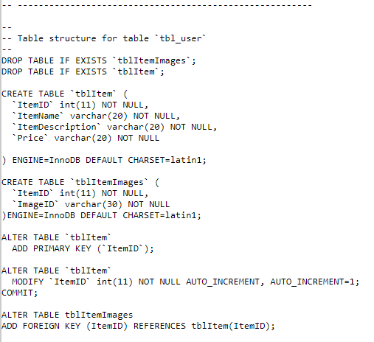
Create Database Tables
Write the SQL code below and execute in phpMyAdmin to create two database tables. Item details will be stored in the first table (tblItem) and item image references (a single item may have multiple images) will be stored in the second table (tblItemImges)

Slide 5
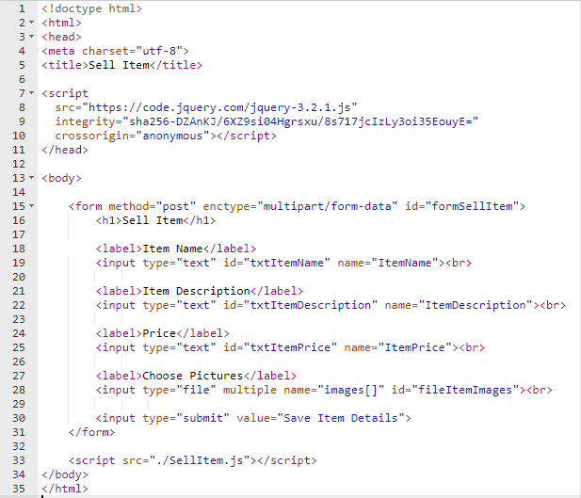
SellItem.html
use multipart/form-data when your form includes any <input type="file"> elements
multiple attribute is used to select more than 1 file

Slide 6
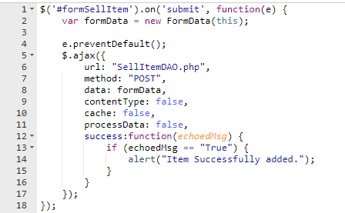
SellItem.js
Same as previous week, send form data to a php server using ajax

Slide 7
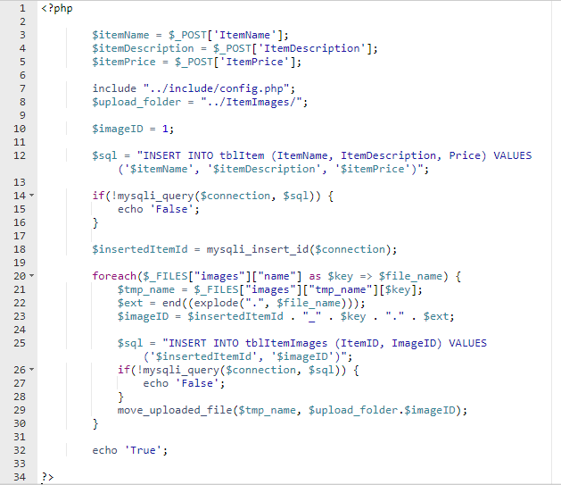
SellItemDAO.php
There is one global PHP variable called $_FILES. This variable is an associate double dimension array and keeps all the information related to uploaded file. So if the value assigned to the input's name attribute in uploading form was images, then PHP would create following five variables −
$_FILES['images ']['tmp_name'] − the uploaded file in the temporary directory on the web server.
$_FILES['images']['name'] − the actual name of the uploaded file.
$_FILES['images']['size'] − the size in bytes of the uploaded file.
$_FILES['images']['type'] − the MIME type of the uploaded file.
$_FILES['images']['error'] − the error code associated with this file upload.

Slide 8

Upload files and folders
Upload all the implemented files and folders to your studentsites server (in public_html folder)
Open ItemSell.html in a browser window
Enter item details and select multiple images and click save button
An alert will be shown as below
Check the database tables (tblItem, tblItemImages) and the ItemImages folder in the server. You will see New records in the database tables and physical image files in the ItemImages folder

